Slide 1

Machine Learning:
Games rating
Tian Xie, Eric Yang

Slide 2

Overview
The gaming industry has grown into a highly competitive and innovative market, with thousands of games launched annually on platforms like Steam. Understanding the factors that drive the success of a game is critical for developers, publishers, and stakeholders to make informed decisions about game design, marketing strategies, and resource allocation.

Slide 3
Objectives
Identify factors contributing to the success of games on Steam.
1
2
Predict positive ratings using game metadata, user tags, and other features.

Slide 4
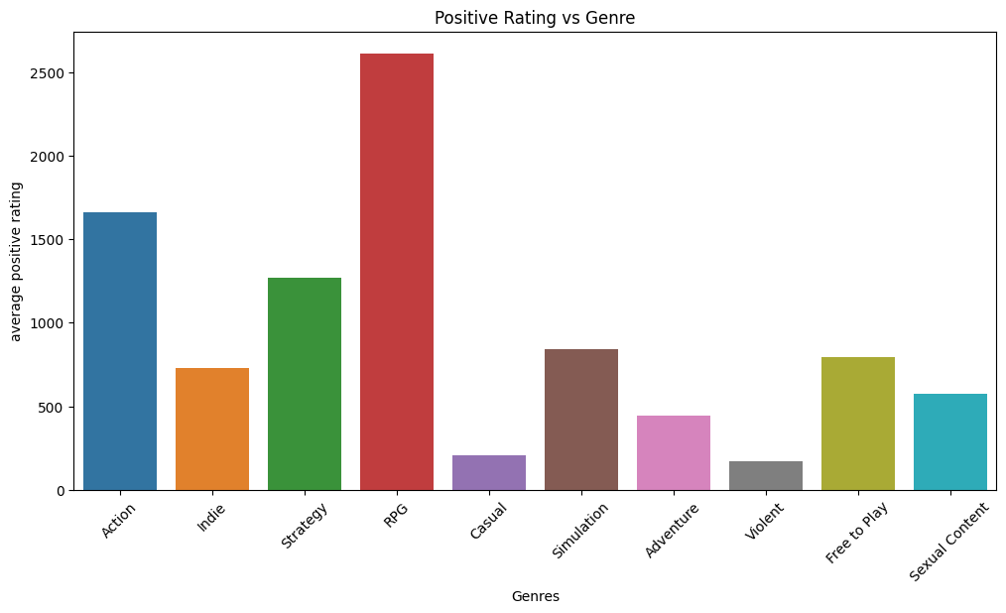
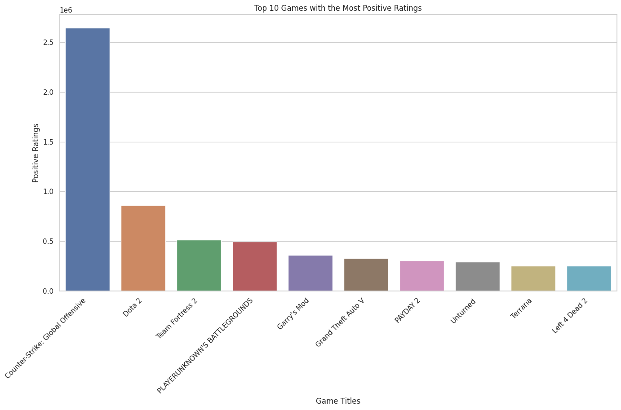
Dataset and Features
Combined data of 27,000 games scraped from Steam and SteamSpy APIs
Steam Data: Game metadata (developer, price, release date, ratings).
SteamSpy Tags: User-generated tags and their vote counts.
System Requirements: Minimum and recommended specifications.

Slide 5



Data Preprocessing
Features Engineering
Data cleaning
Encoding
01
03
Normalized tag votes to represent the proportion of each tag's importance per game. Extract year and month from the release_year
02
Handled null values in system requirements and tag data.
Converted categorical variables (e.g., genres, categories) to numerical representations using one-hot encoding.

Slide 6
There are too many types of categorical features, and directly using one-hot encoding can make the data overly complex and pose a risk of potential overfitting. Therefore, we consider using Principal Component Analysis (PCA) for dimensionality reduction and define a function to compare the effects of the two methods.
Original
PCA

Slide 7
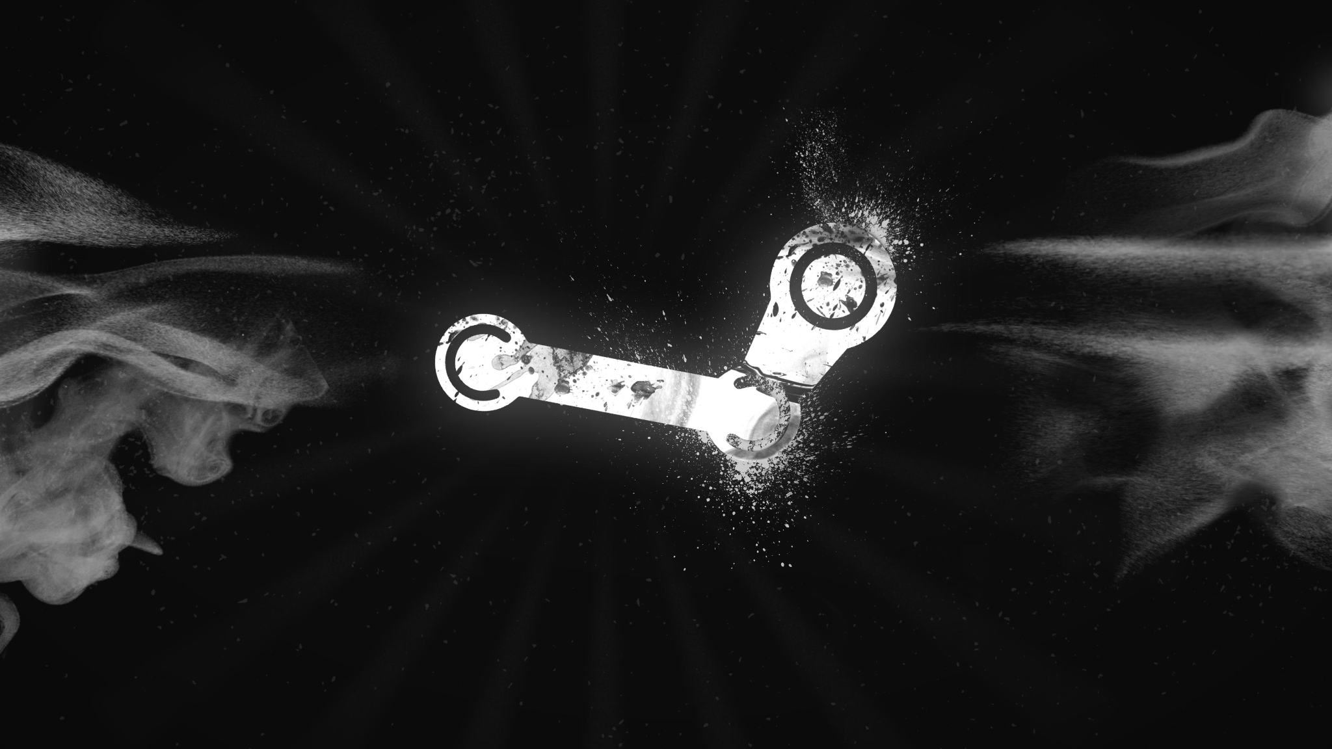
Model Training
80% train 20%test

Slide 8
Linear Regression
01
Simplest model
Key limitations:
Struggles with non-linear interactions and high-dimensional data like tags.

Slide 9
Neural Networks
02
Captures complex interactions between features.
Limitations:
Neural Networks might be overkill here
Use simpler model that does not require deep learning

Slide 10
Random Forest
03
Effective at capturing non-linear relationships.
Handles high-dimensional data like tags well without extensive preprocessing.
Feature importance analysis helps interpret predictions.

Slide 11
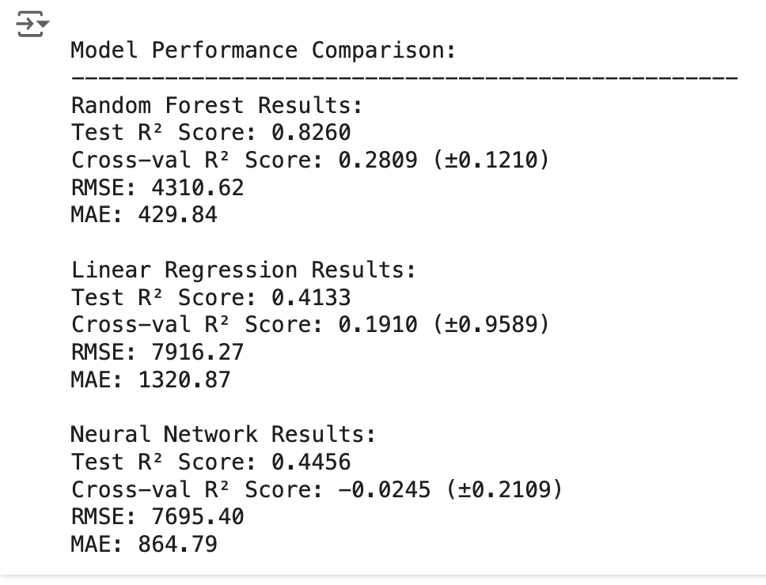
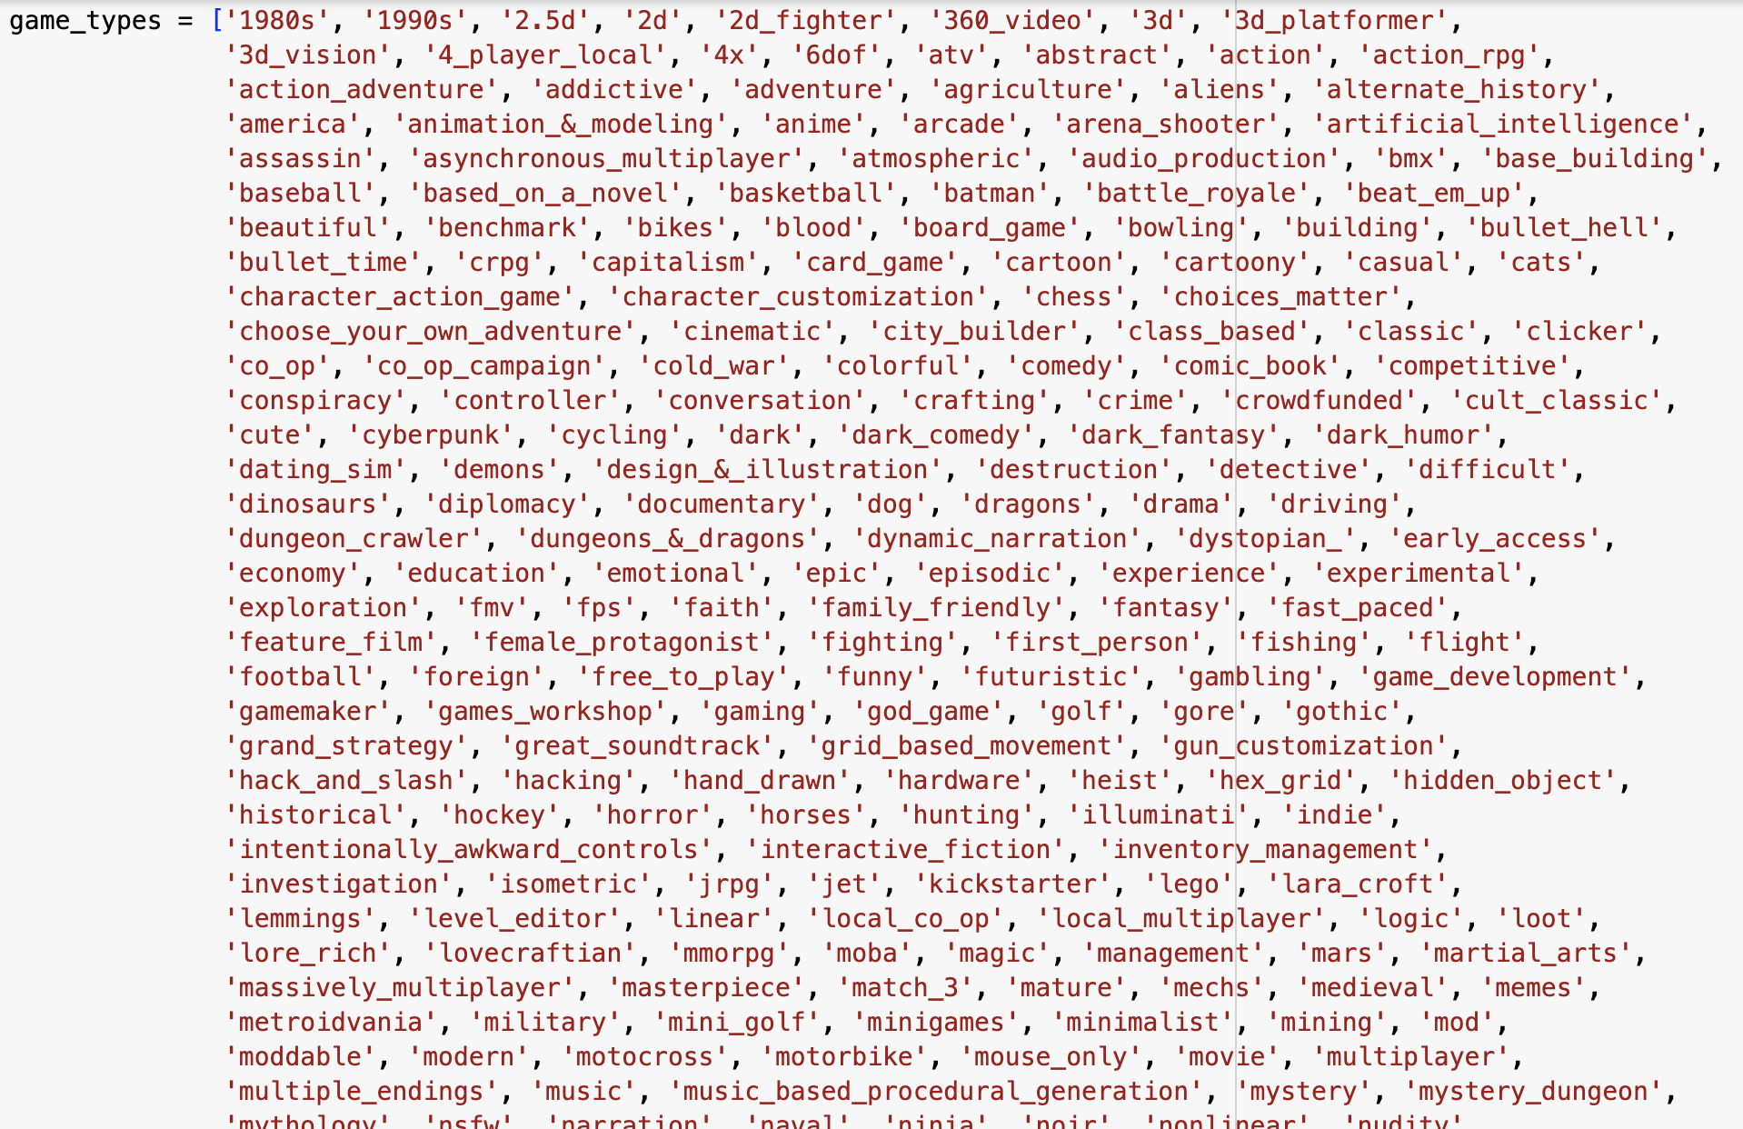
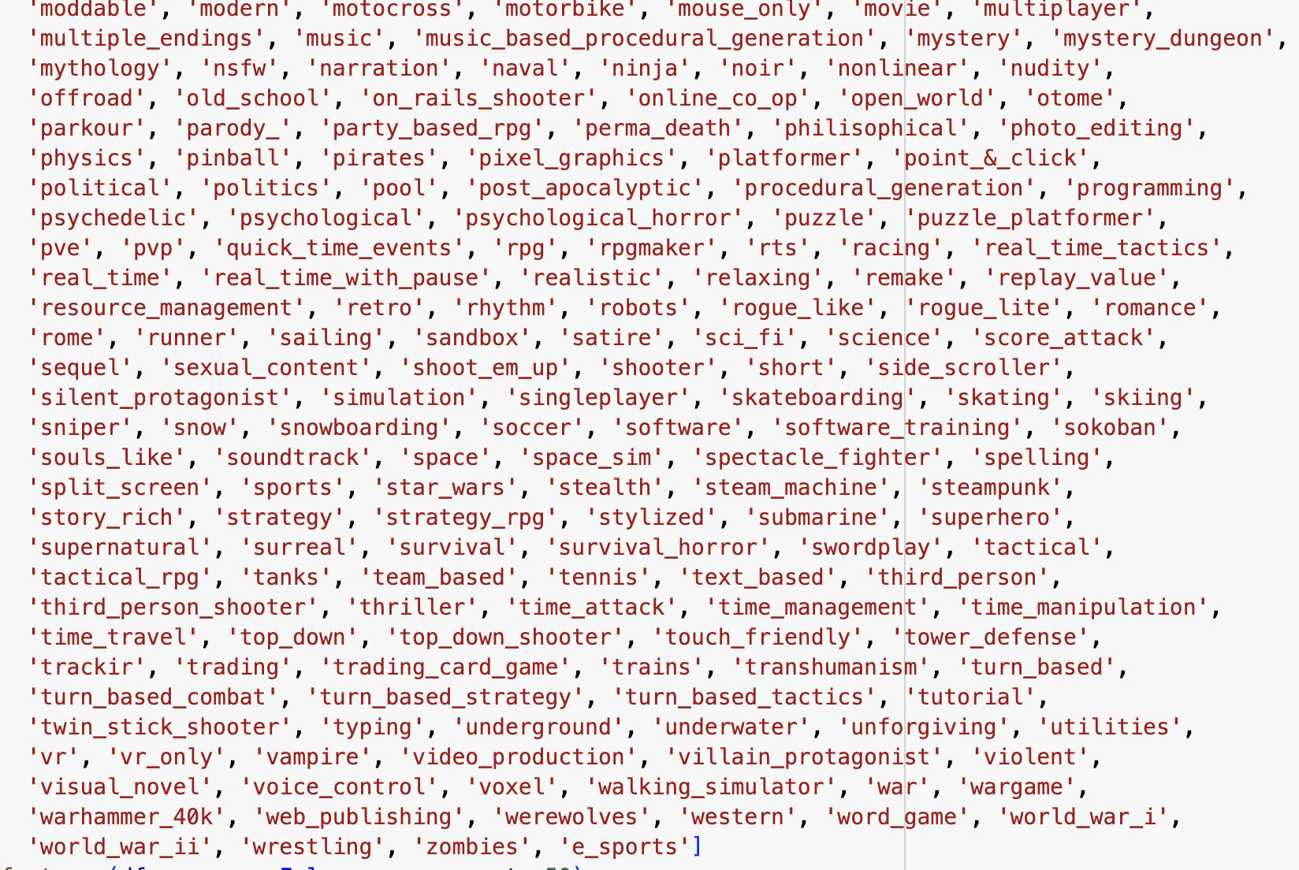
Performance
Model include all game tages

Slide 12
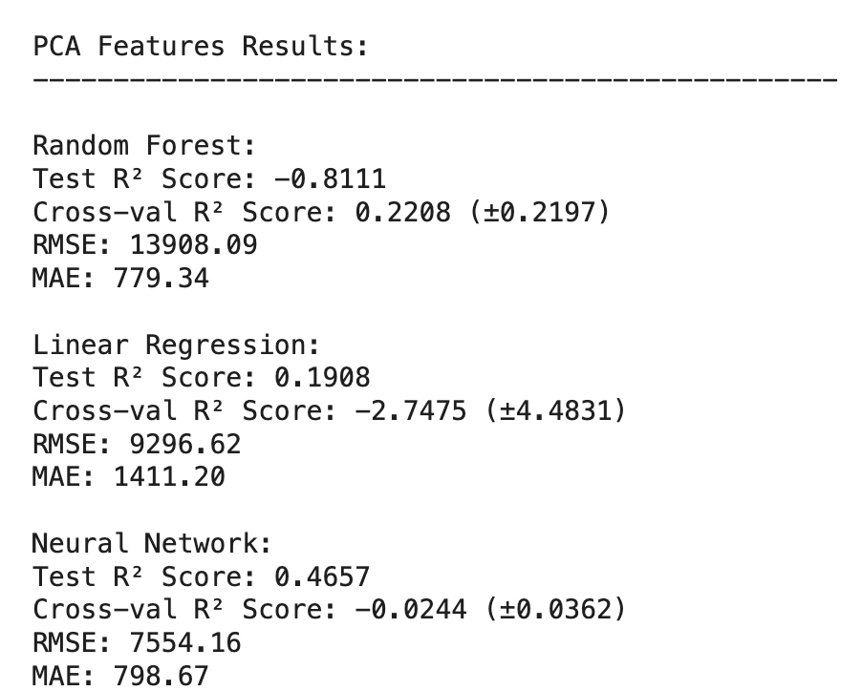
Performance
Model using PCA

Slide 13
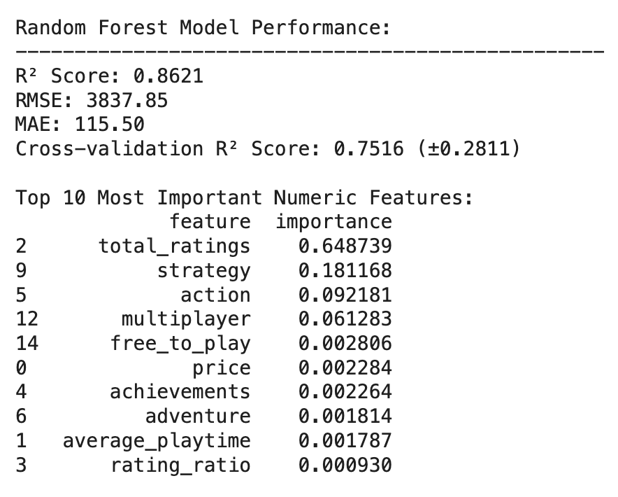
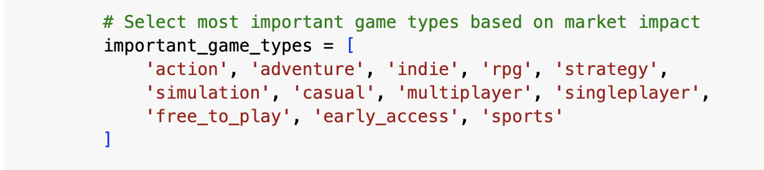
Performance
Module with less game tages

Slide 14
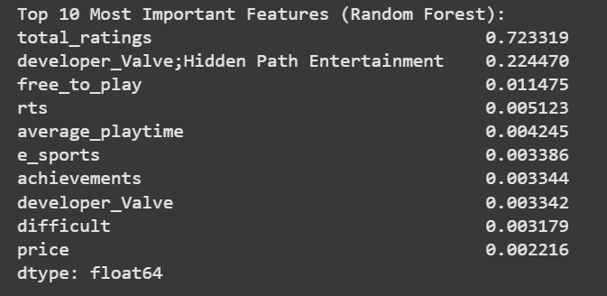
Segmenting Analysis on Tags
Normalize the tags as a measurement of how strongly certain tags act on the predictions
Tags & Genre-Specific Analysis: Certain genres may respond differently to various factors (e.g., narrative depth for RPGs versus multiplayer dynamics for shooters). Understanding these nuances can aid developers in creating genre-appropriate gameplay and marketing strategies
CEO
CFO
Sales Director
Wendy Writer

Slide 15
Future Analysis
Trend Analysis Over Time: Conduct longitudinal studies to analyze how player preferences evolve over time or how the gaming landscape shifts (e.g., in response to technological advancements or changing social norms). This can help developers anticipate future trends and adjust their strategies accordingly.

Slide 16


